Slide 1
Figurative Language & Literary Devices

Slide 2
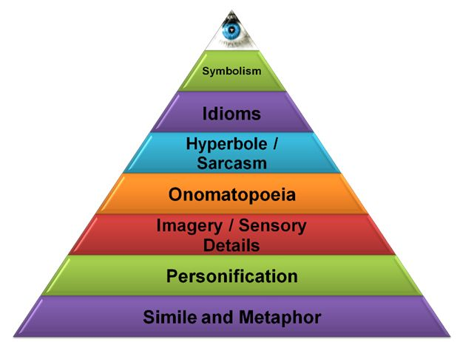
Figurative Language

Slide 3
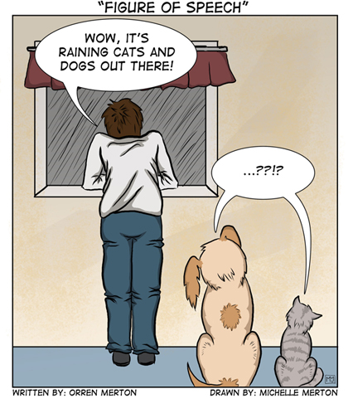
Figures of Speech
A word or phrase that describes one thing in terms of another and is not mean to be understood as literally true.
Examples: metaphor, simile, hyperbole, personification, analogy, idiom, alliteration, onomatopoeia, etc.

Slide 4
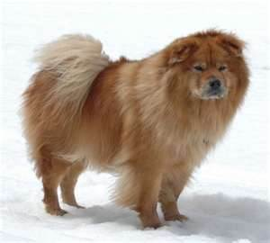
Metaphor
An imaginative comparison between two unlike things in which one thing is said to be another thing.
Example:
My dog is a bear
“The Sun is a flower that blooms for just one hour.” – “All summer in a day” – Ray Bradbury

Slide 5
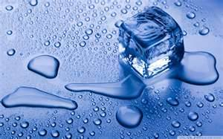
Simile
A comparison between two unlike things, using a word such as LIKE, AS, RESEMBLES, or THAN.
Examples:
The day was as cold as an ice cube.
The girl is like a rose.

Slide 6
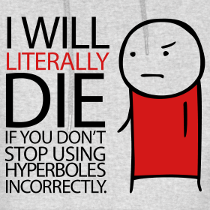
Hyperbole (exaggeration)
Overstating something, usually for the purpose of creating a comic effect.
An exaggeration. Used to express items in extremes.
Examples:
The test took forever!
He was so slow the statue moved more quickly.
She looked 150 years old.

Slide 7
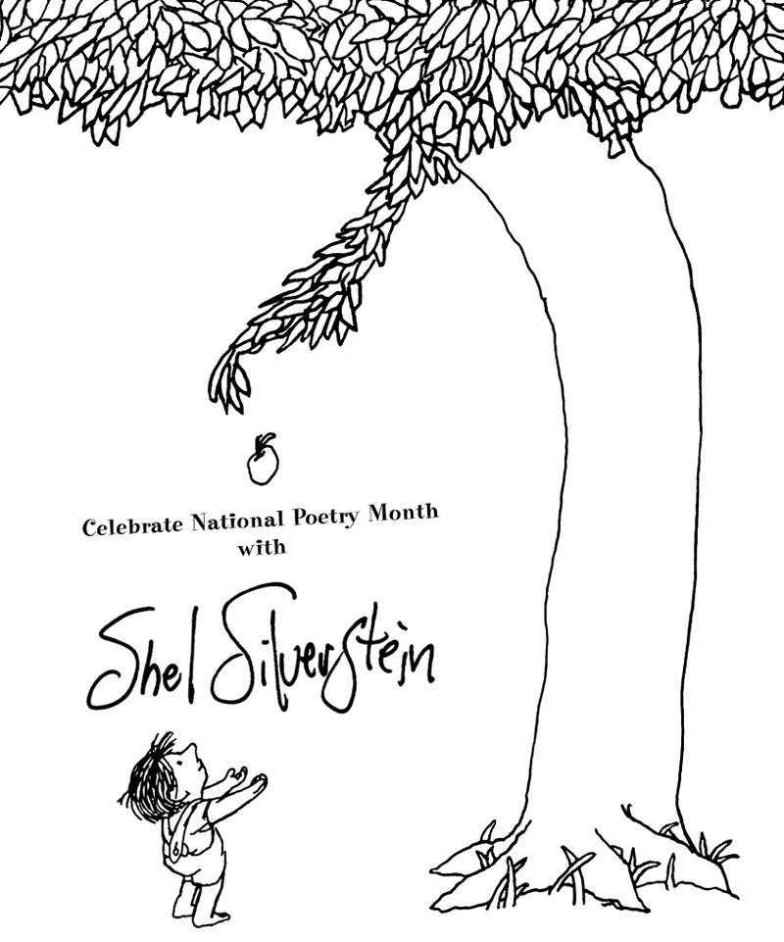
Personification
An object or animal is spoken of as if it has human feelings, thoughts or attitudes.
Examples:
The ocean sang to me.
The lightening danced across the night sky.

Slide 8
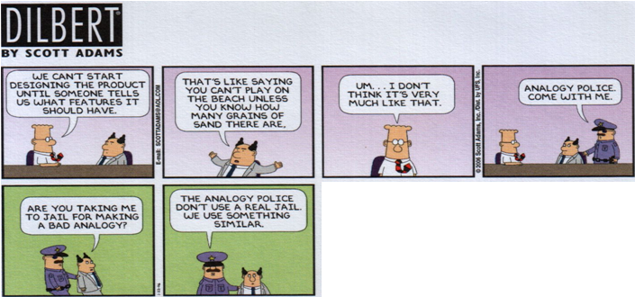
Analogy
A comparison made between two things to show how they are alike.
Analogies include an explanation to show the similarities between the objects.

Slide 9
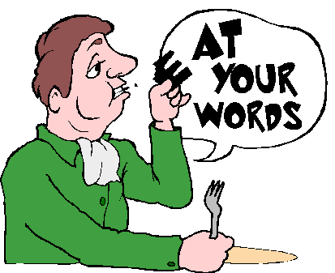
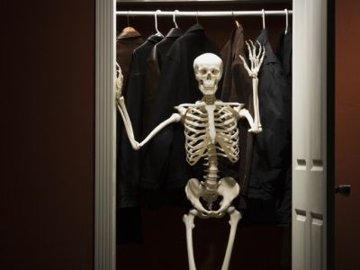
Idiom
An expression peculiar to particular language that means something different from the literal meaning of the words.
Phrases we use to describe certain events or situations.

Slide 10
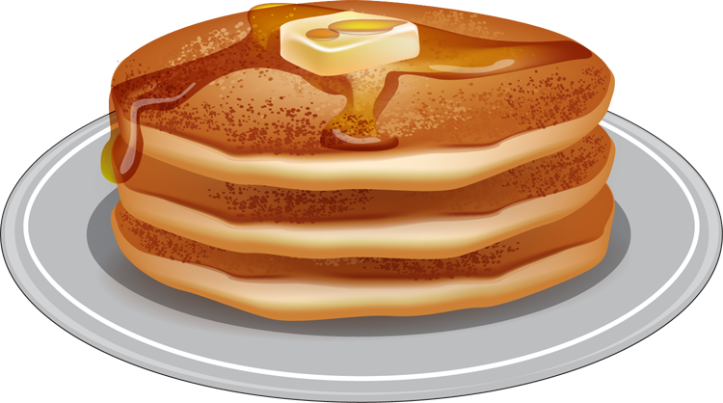
Alliteration
The repetition of consonant sound in words that are close together
Examples:
“A little alliteration lets the lesson linger longer.”
Friendly Frank flips fine flapjacks.
The parapets poppies bloomed.

Slide 11
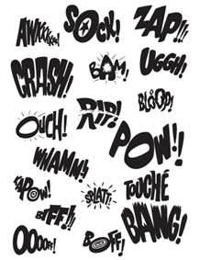
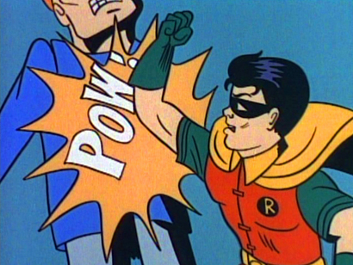
Onomatopoeia
The use of words whose sounds imitate or suggest their meaning.

Slide 12
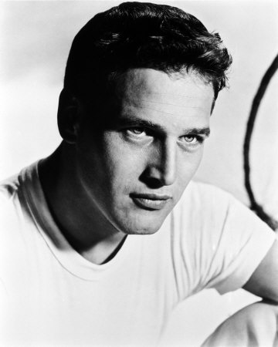
Allusion
Example: “When I stepped out into the bright sunlight from the darkness of the movies house, I had only two things on my mind, Paul Newman and a ride home.” (The Outsiders, Hilton)
A reference to a statement, a person, place, or an event from literature, the arts, history, religion, mythology, politics, sports, science, or pop culture

Slide 13
Literary Devices

Slide 14
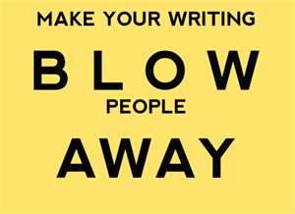
(Author’s) Style
The way a writer uses language to convey a meaning
Example: diction, sentence structure, tone, literary devices, and the use of figurative language.

Slide 15
Diction
A writer’s or speaker’s choice or words. (Word Choice)
Diction contributes to the author’s style and tone.
There is connotation (implied meaning) and denotation (dictionary meaning)
Example: “She was invaded by one of those twenty-four hour flu bugs that sent her to bed with a fever…” (“The Moustache”, Robert Cormier)

Slide 16
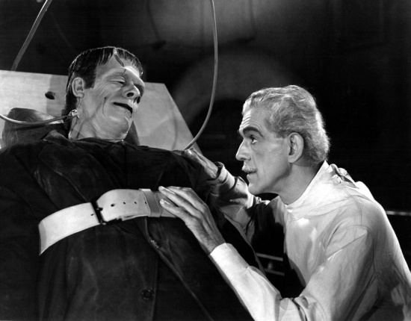
Tone
Example:
“Life and death appeared to me ideal bounds, which I should first break through, and pour a torrent of light into our dark world.” – Frankenstein
This creates an ominous or gloomy tone.
The attitude a writer takes toward his or her subject, characters, and audience.
Think tone of voice. It may be humorous, passionate, sincere, or ominous.

Slide 17
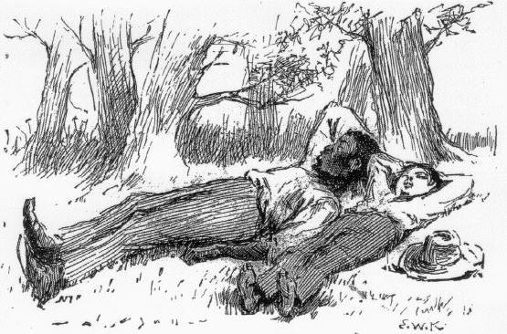
Dialect
A way of speaking that is characteristic of a certain geographical area or a certain group.
Example:
Jim: “We’s safe, Huck, we’s safe! Jump up and crack yo’ heels. Dat’s de good ole Cairo at las’ I jis knows it.”
Huck: “I’ll take the canoe and go see, Jim. It mightn’t be, you know.”
- Huck Finn by Mark Twain

Slide 18
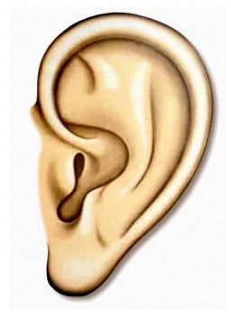
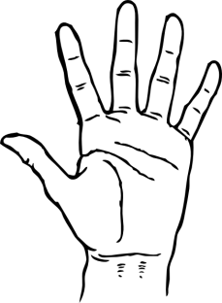
Imagery
Language that appeals to the senses: sight, sound, smell, touch and taste.
Allows the reader to create a “mental picture”
Descriptive details are needed to create imagery
Figurative language is used to create this.
Examples:
“He could hear his world crashing down when he heard the news about her.”
“The taste of that first defeat was bitter indeed.”

Slide 19
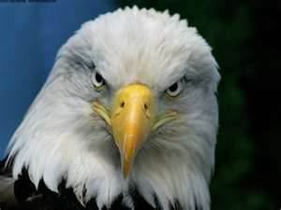
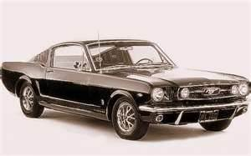
Symbol
A person, place, thing or an event that has meaning in itself and stands for something beyond itself as well.
Examples:
The bald eagle is a symbol of freedom for Americans.
In The Outsiders, madras and mustangs symbolized the Socs.

Slide 20
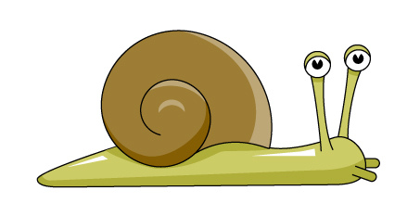
Irony
A contrast between what is expected and what actually happens.
Example:
Melinda Alice had a big math test coming up and she was granted three wishes. She made wishes that revolved around her materialistic wants. When she arrives at school, she remembers she didn’t study for her math test. She then states “I wish I were dead.”

Slide 21
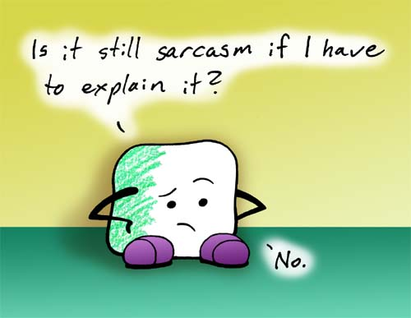
Verbal Irony
Involves a contrast between what is said or written and what is really meant.
Example: Sarcasm

Slide 22
Irony of Situation
Example:
The case of Melinda Alice was situational irony.
Occurs when what happens is very different from what we expected would happen.

Slide 23
Dramatic Irony
Occurs when the audience or reader is aware of something the character is not.
In the play Anne Frank, Anne believes that she will be safe, but the audience knows that she will be caught.

